Slide 1
HTML classes

Slide 2
Agenda
HTML class
HTML class syntax
Sample output
HTML class implementation

Slide 3
HTML class
HTML classes are like functions in java where we have some set of HTML code written, which can be used in any of the tags we need it for.
We use class keyword in the tag and declare the class in head of the HTML file.

Slide 4
HTML class syntax
<html>
<head>
<style>
.class name 1{
Property1: value
Property2: value
}
</style>
</head>
<body>
<Tag name class =”class name 1”> Text here</Tag name>
<Tag name class =”class name 1”> Text here</Tag name>
</body>
</html>

Slide 5
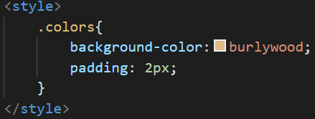
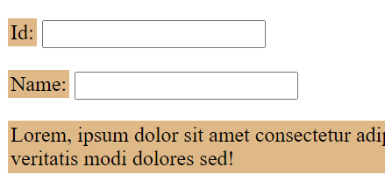
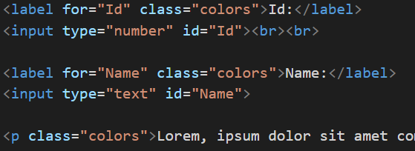
Sample output
Output
From Head tag
From Body tag

Slide 6
HTML class implementation
Let’s see implementation of HTML Class.

Slide 7
Summary
We have seen how to use HTML class and id to style text in the page.
DO NOT WRITE ANYTHING
HERE. LEAVE THIS SPACE FOR
WEBCAM

Slide 8
Thank You
Proprietary content. ©Great Learning. All Rights Reserved. Unauthorized use or distribution prohibited

